Slide 1



ReEd Solomon decoder using uart
Giannis reinos | Dimitris tsalapatas
03-04-2023

Slide 2

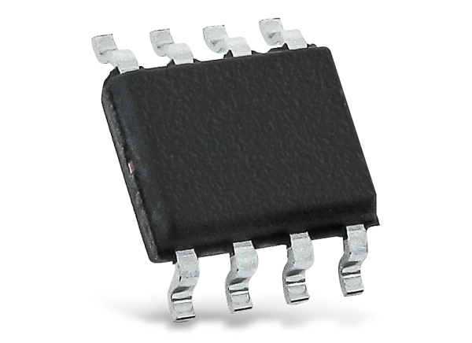


DESIGN APPLICATIONS
The purpose of the chip is to receive data from a Reed Solomon Encoder via UART and decode them using the Reed Solomon Decoder.
Uses in real world applications: Digital broadcasting, Mobile phone networks, CD and DVD storage, Data storage.

Slide 3
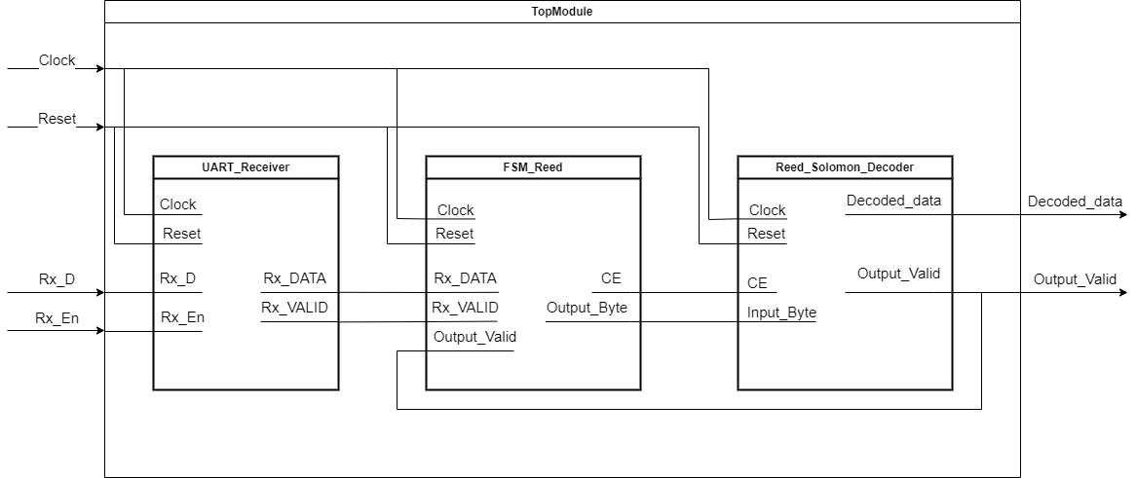
DESIGN DATAFLOW

Slide 4
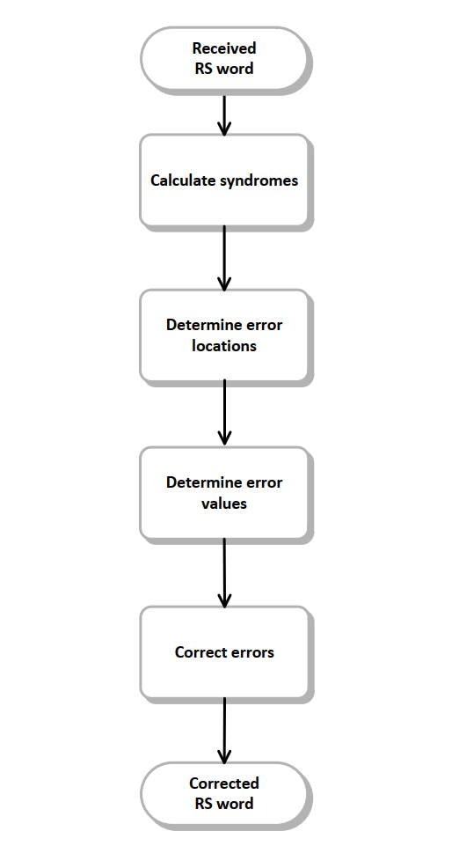
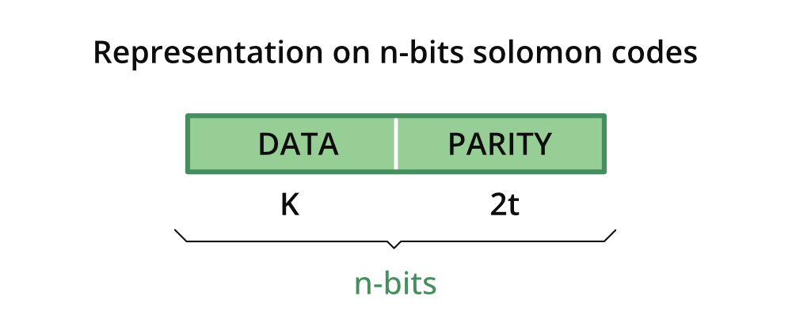
REED SOLOMON DECODER
Reed-Solomon decoding is a technique used to correct errors in data transmissions, particularly in digital communication systems. It is a type of forward error correction method that uses redundant information to detect and correct errors that may occur during transmission.

Slide 5
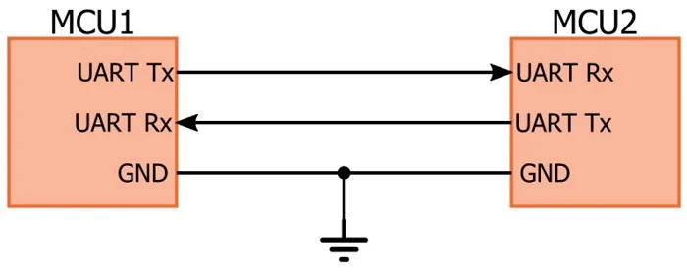
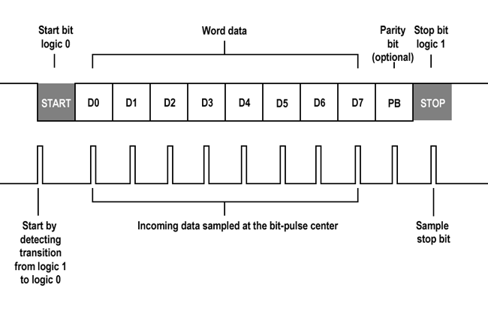
UART RECIEVER
We use UART Receiver to receive data from the Reed Solomon Encoder and to provide them for decoding in Decoder.
The speed of Serial communication is at baud rate 115200 which is the maximum speed for this protocol

Slide 6
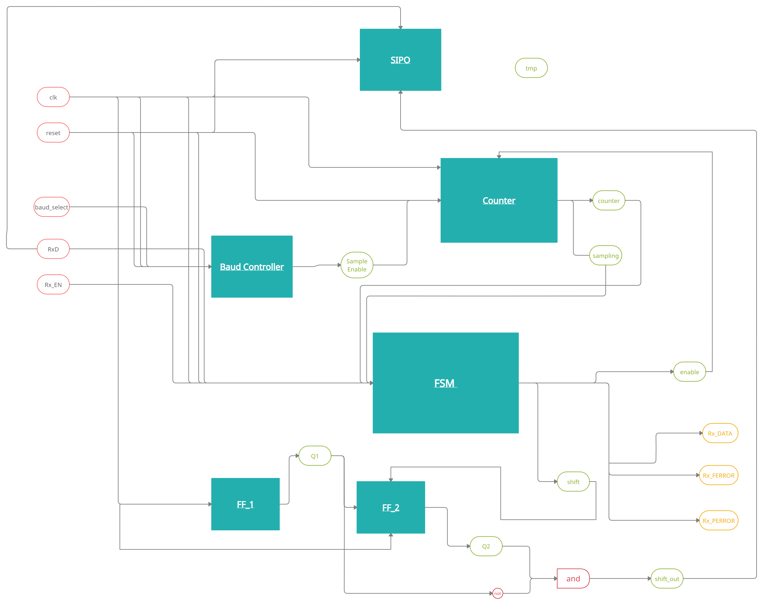
UART RECIEVER DATAFLOW

Slide 7
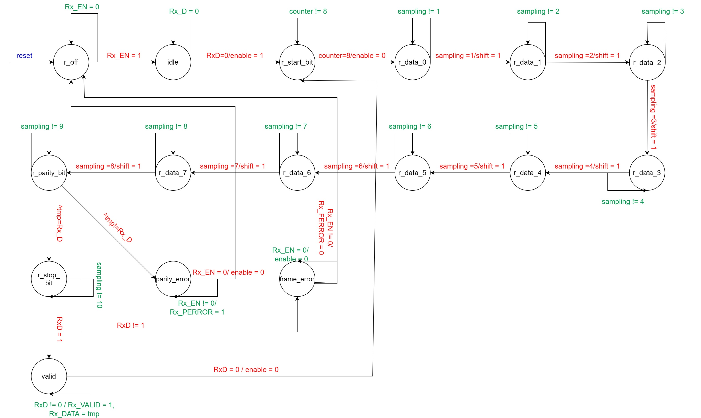
UART RECIEVER FSM

Slide 8
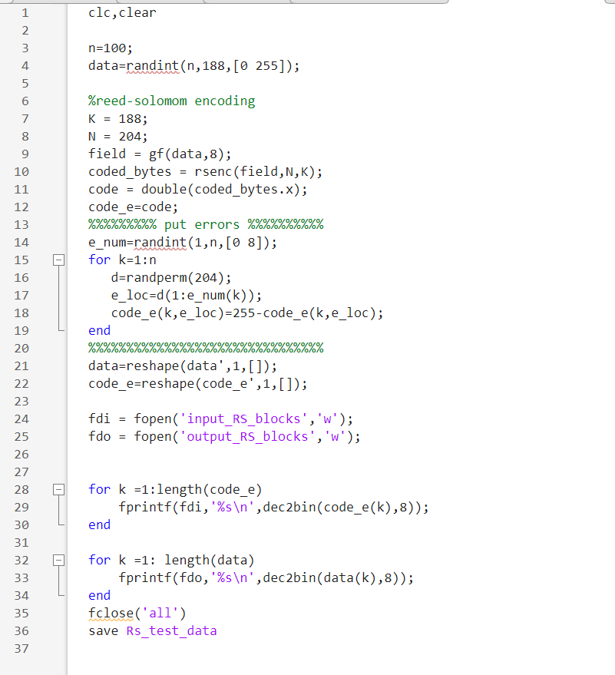
Design Simulation
We simulate the output of a Reed Solomon Encoder and a UART Transmitter that sends 8 bits at baud rate speed of 115200.
The input is an 8-bit register and in order to start decoding it needs 204 bytes.
The combinations of inputs are unlimited, because there is a Matlab script that generates vectors for input and output. We simulate using 100 of them

Slide 9
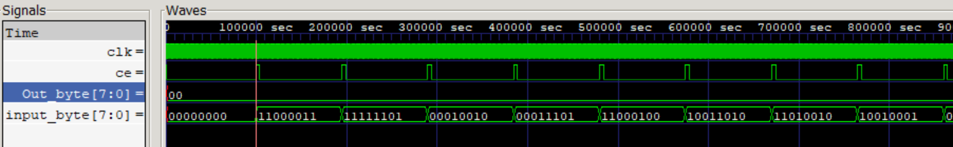
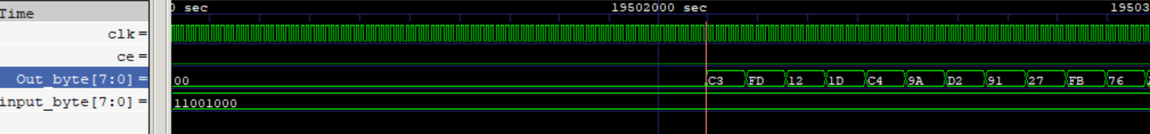
Design Simulation
Input Transmission
Decoding

